Slide 1
Proposal Presentation
G1T5

Slide 2
Table of Contents
01
02
03
04
Introduction
Business Needs
Key Use Cases
Design Views
AWS Diagram
Deployment Diagram
Budget
Services used
Cost
Key Design Decisions
Quality Attributes
Architecture

Slide 3
01
Introduction
Business Needs and Key Use Cases

Slide 4
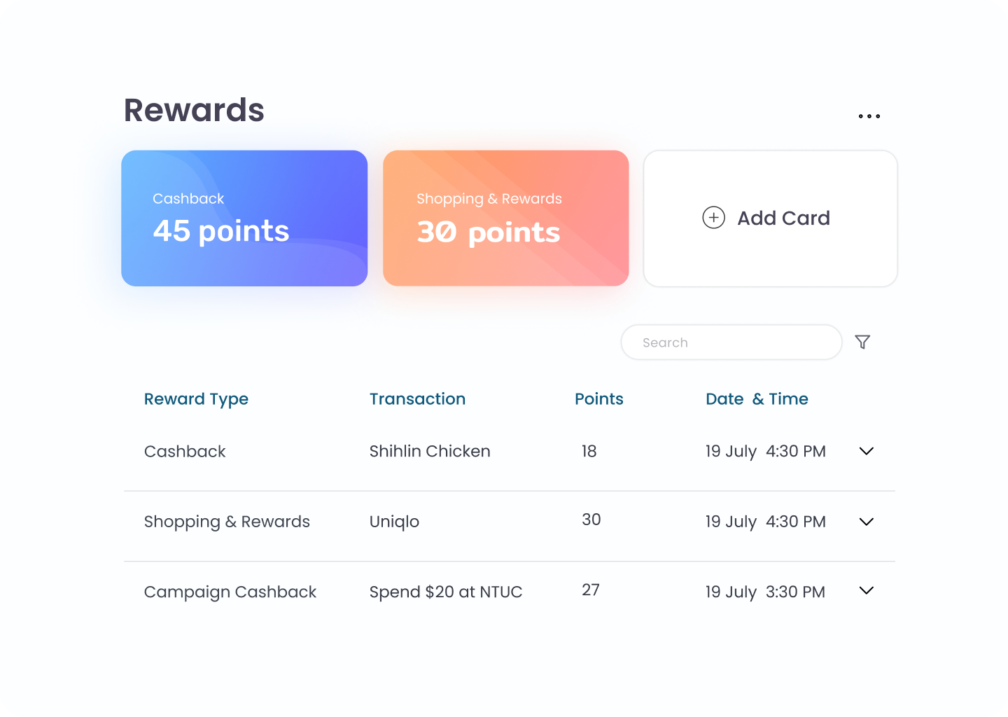
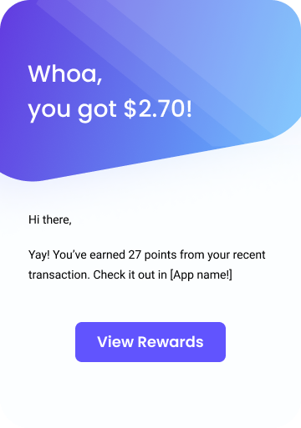
Business Needs / Key Use Cases
Transactions
Point System
Campaign
Process from CSV files and from API calls
Process and store points accumulated by customers from different cards
Launch and handle campaigns in collaboration with merchants

Slide 5
02
Design Views
AWS and Deployment Diagrams

Slide 6
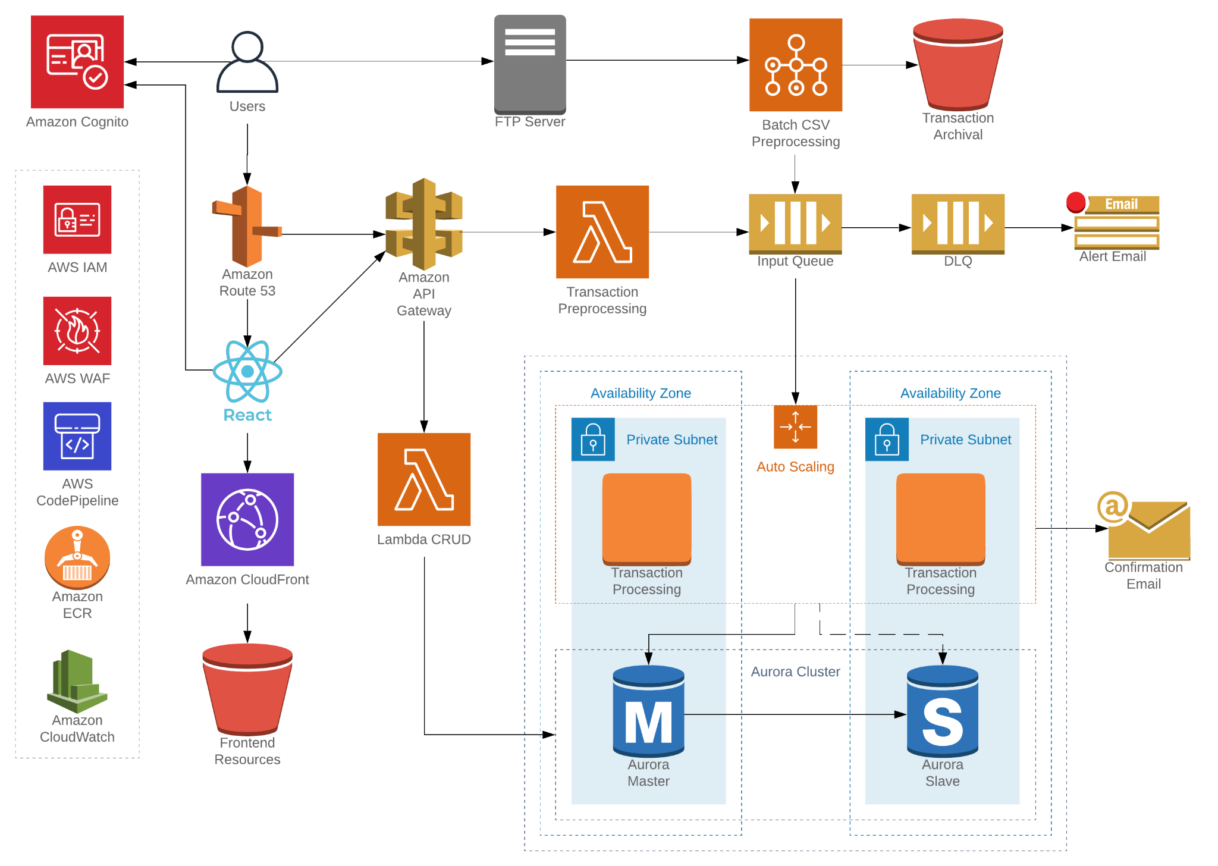

Slide 7
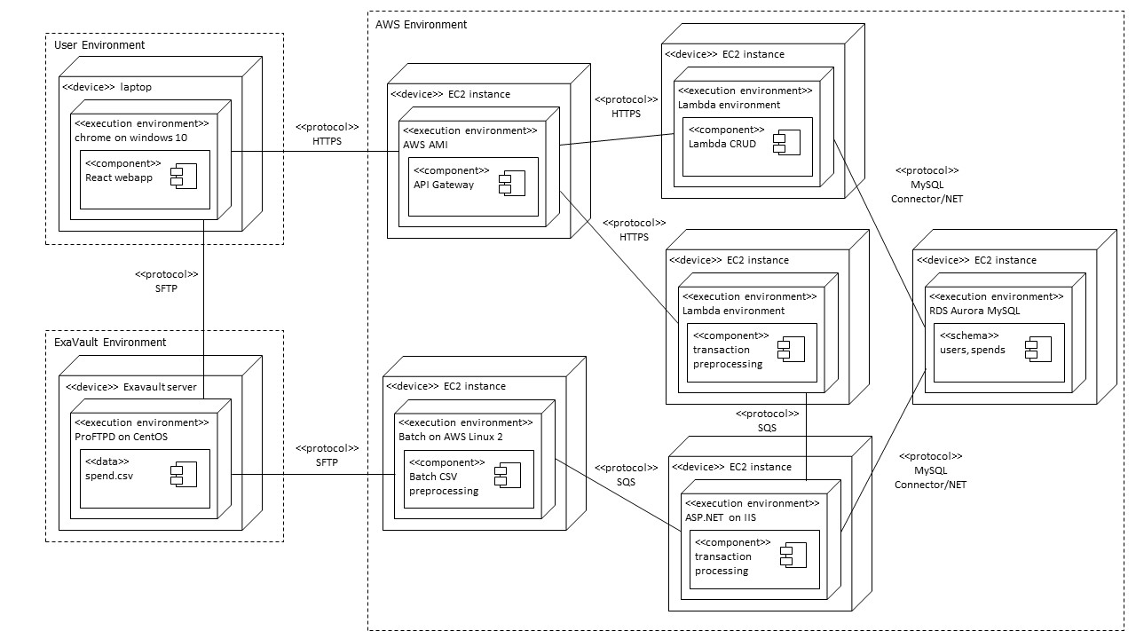

Slide 8
03
Budget
Services Used and Cost Breakdowns

Slide 9
Development
Activity/ Hardware/Software/ Service | Description | Cost
Developing code, tests and documentation | Total cost to develop and test services for the product | 5 * 30 man-hours/person = 150 man-hours
Continuous integration and deployment - AWS CodePipeline | Costs associated with building, integrating and deploying code | $200 (AWS credits)
Cloud services for development and staging environment | Costs associated with experimental cloud services used for development

Slide 10
Production
Activity/ Hardware/Software/ Service | Description | Cost (est. monthly)
Compute - EC2, Batch | VMs | $142.80
Compute - Lambda | Serverless compute | $28.37
Storage - Aurora | Databases, replication etc | $249.64
Misc - API gateway, Cloudwatch, Cognito, ECR, SQS, S3 | Additional miscellaneous services | $13.10
Maintenance | Code revisions and changes | 5 man-hours

Slide 11
04
Key Design Decisions
Quality Attributes and Architecture

Slide 12
Quality Attributes
Maintainability
Security
01
02
Code
Architecture
MITM Attack
SQL Injection
DDos Attack
Performance
Availability
03
04
Parallelization
Concurrency
Edge Optimisation
Multi-AZ deployment

Slide 13
Maintainability
Code
Architecture
Reusable code through object-oriented design
Purposeful documentation
Test-driven development
CI/CD pipelines
Building on top of layered AWS service stack
Provisioning infrastructure as code with CloudFormation
VCS for architecture

Slide 14



Security
DDOS Attack
SQL Injection
MITM Attack
Web Application Firewall
AWS Shield
User Input Sanitisation
Prepared Statements
Object Relational Mapping
Web Application Firewall
SSL/TLS encryption

Slide 15



Performance
Parallelization and Concurrency
AWS Aurora database
Edge Optimisation
.NET’s ability for asynchronous and parallel coding
Auto-scaling to meet workload
5x standard MySQL throughput
Read Replicas
In-memory cache
EC2 Regional Placement
Lambda’s Provision Concurrency
AWS Cloudfront CDN
Notes:
TechEmpower Performance Benchmark: https://www.techempower.com/benchmarks/#section=data-r20

Slide 16
Availability
EC2
Aurora
Multi-AZ auto scaling groups
Decoupled, stateless jobs
Multi-AZ read replica
Automatic failover
Lambda
Frontend
Highly available FaaS
Run across multiple AZs
Multiple S3 regions
CloudFront automatic origin failover

Slide 17
Thank You

